Slide 1


🎯 AI-Powered Phishing Detection Systems
📅 Date: [14-7-25]
🛡️ “Secure the future by detecting threats with intelligence.”
👨‍💻 Presented by: Partha Podder
1

Slide 2
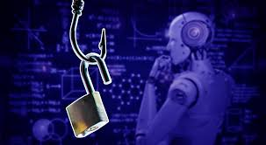
Introduction to Phishing
🔍 What is Phishing?
A cyberattack that tricks users into revealing sensitive data (passwords, credit card numbers, etc.)
⚠️ Consequences of Phishing:
Identity theft
Financial loss
Unauthorized access
Organizational data breaches
2

Slide 3

Why AI for Phishing Detection?
🤖 Benefits of AI in Phishing Detection:
🧠 Learns from patterns of past attacks
⚡ Fast, real-time classification
🔁 Adapts to new phishing techniques
📈 Scalable for large datasets
3

Slide 4

Types of Phishing Attacks
🎯 Spear Phishing
📱 Smishing & Vishing
🌐 URL-Based Phishing
📧 Email Phishing
Fake messages from "trusted" sources
Targeted attacks on individuals
Fake SMS and voice calls
Fake websites to steal credentials
4

Slide 5
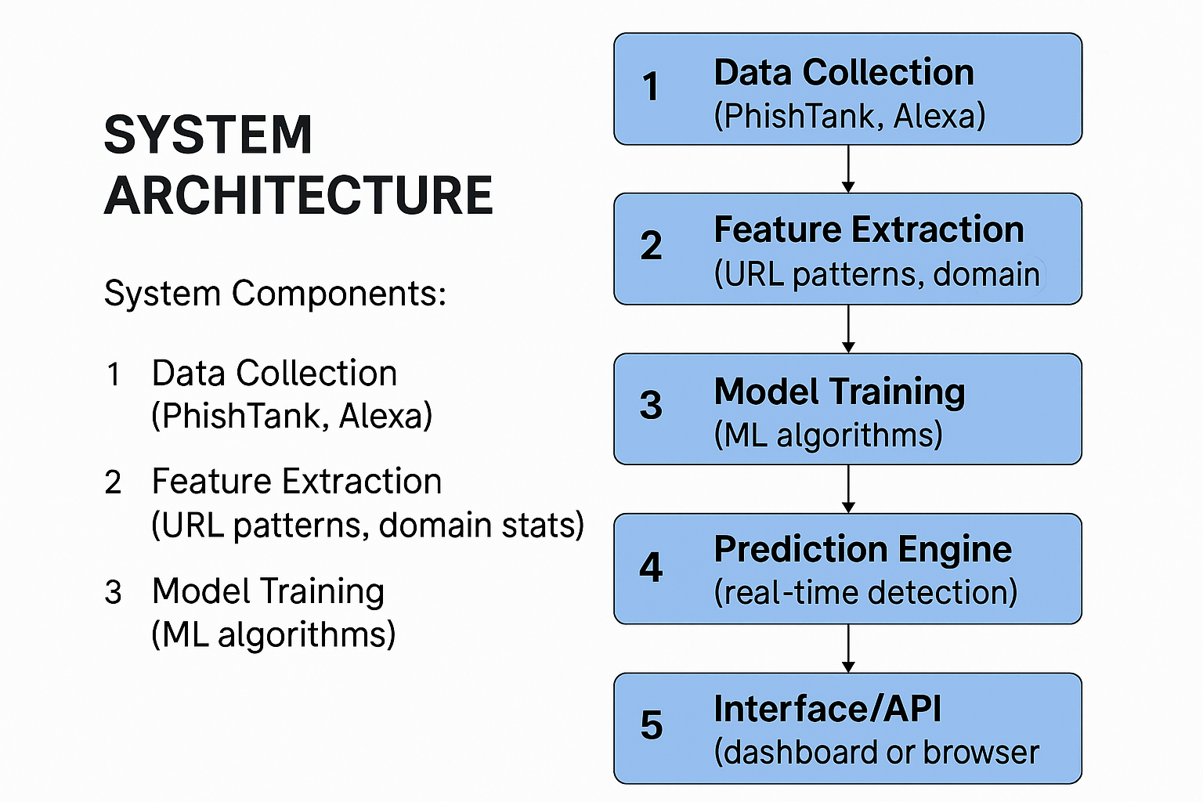
5

Slide 6
Machine Learning Models Used
🔬 Tested ML Models:
✅ Logistic Regression
✅ Random Forest
✅ Support Vector Machine (SVM)
✅ XGBoost
📏 Evaluation Metrics:
✔️ Accuracy
✔️ Precision
✔️ Recall
✔️ F1-Score
7

Slide 7
Results & Deployment
🏆 Top Performer: Random Forest
🎯 Accuracy Achieved: ~97% on test data
🌐 Deployment Options:
🛠️ Flask API for model inference
💻 Streamlit-based detection UI
🔗 Browser extension integration
8

Slide 8
Conclusion & Future Work
✅ Conclusion:
AI can detect phishing with high accuracy
ML models learn evolving phishing patterns
Faster and smarter than rule-based systems
🔮 Future Work:
Deep Learning (e.g., LSTM for email body analysis)
Real-time browser/email integration
Auto-retraining on live phishing feeds
9

